Slide 1
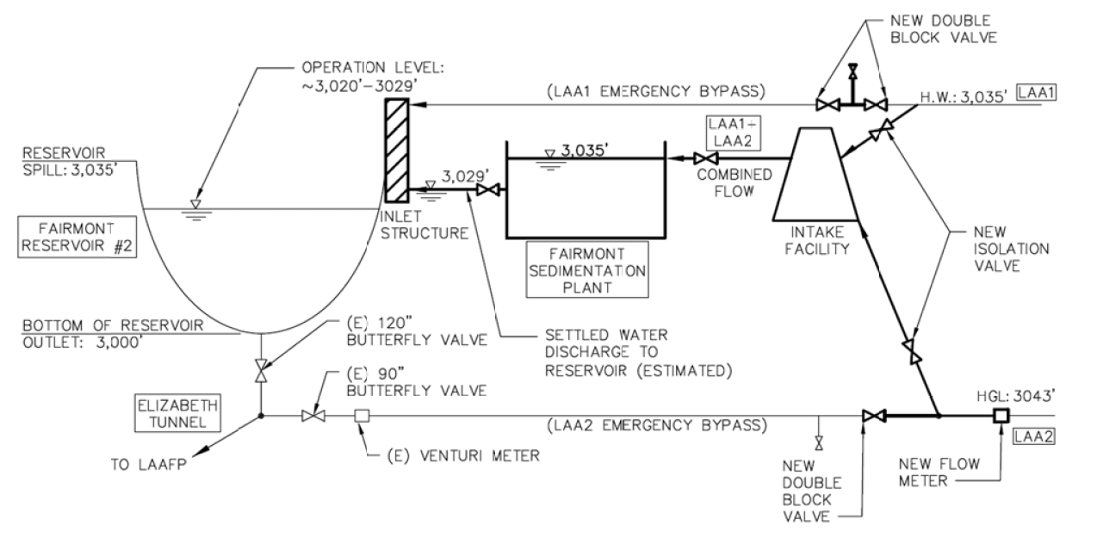
Our UP selection tool matters!

Slide 2
Nomenclature
FSP - Fairmont Sedimentation Plant
SOW – Scope of Work
LADWP - Los Angeles Department of Water and Power
BODR – Basis of Design Report

Slide 3
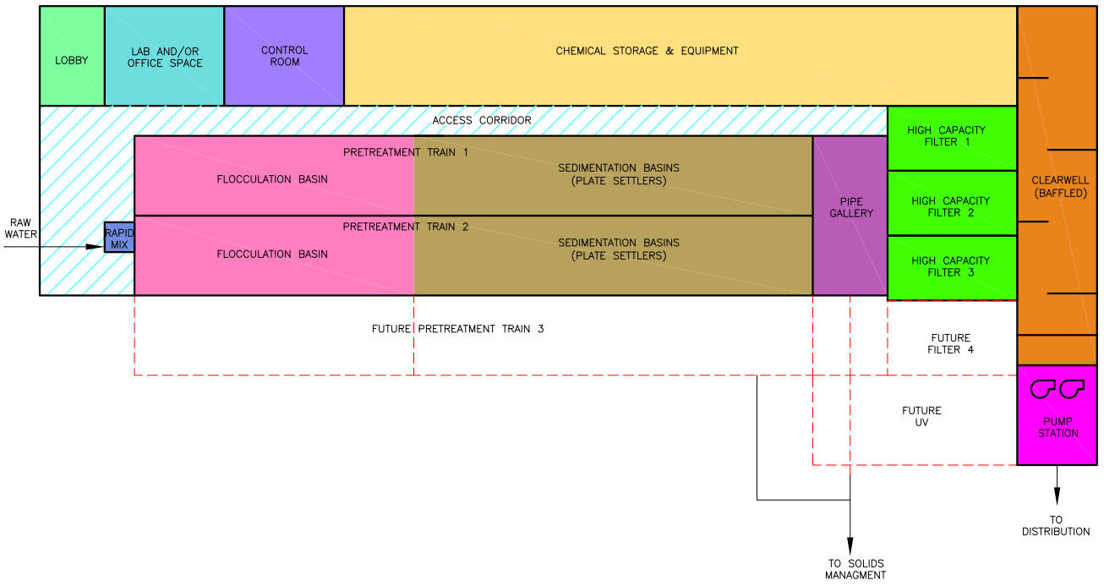
Key word searching: BODR basis of design report municipal water treatment plant sedimentation flocculation
https://www.townofbreckenridge.com/home/showdocument?id=7569
Notes:
https://www.townofbreckenridge.com/home/showdocument?id=7569

Slide 4
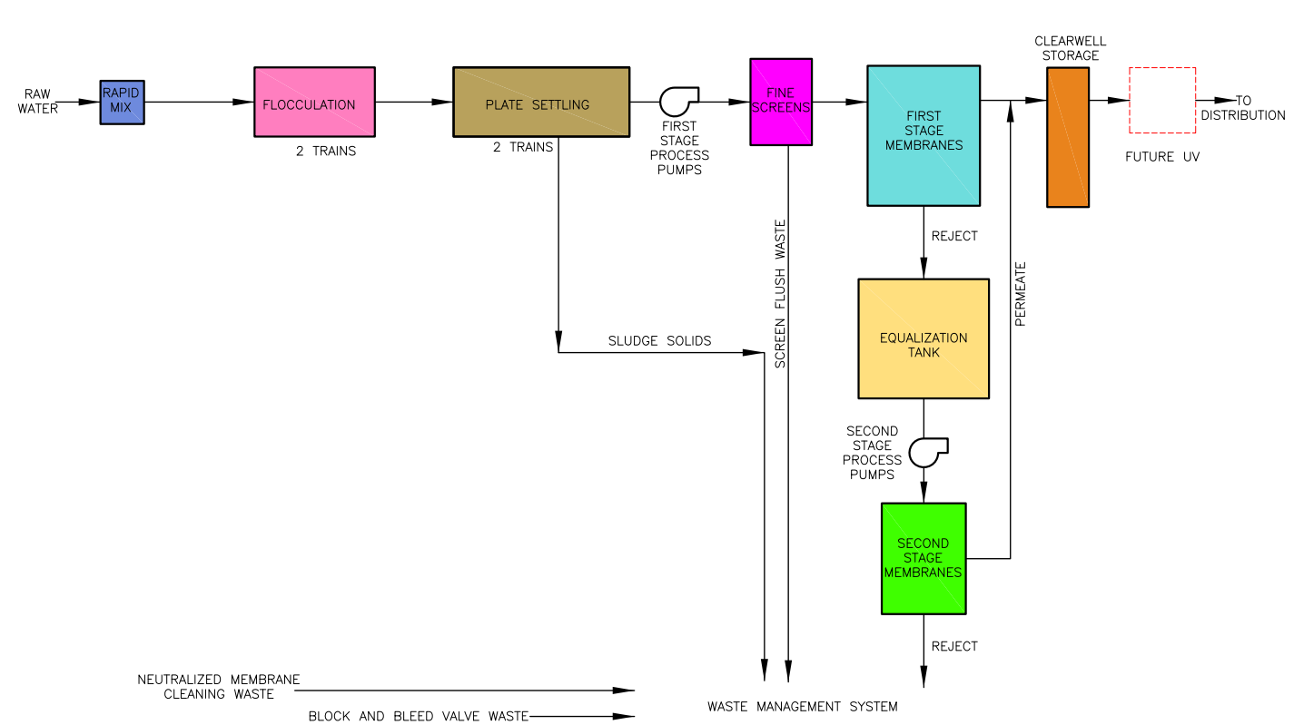
https://www.townofbreckenridge.com/home/showdocument?id=7569
Notes:
https://www.townofbreckenridge.com/home/showdocument?id=7569

Slide 5
How we might approach this design
Process Lead
Design Lead
Rapid Mix/Floc Team
Chemicals Team
Hydraulics Team
Sludge Disposal Team
Sedimentation Team
Other Disciplines
Notes:
Process lead would coordinate and guide the process teams; Design Lead would coordinate between Process Teams and other disciplines.

Slide 6
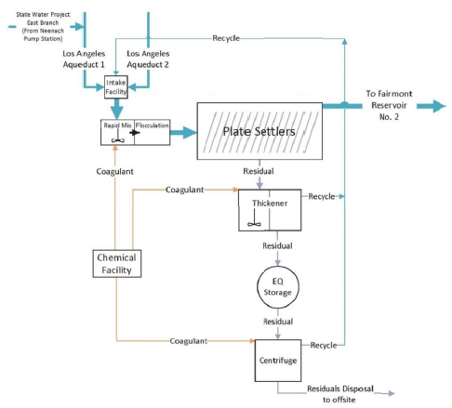
How we might approach this design
Sedimentation Team
Rapid Mix/Floc Team
Chemicals Team
Sludge Disposal
Team

Slide 7
Process Teams’ Responsibilities
Developing calculations to support setting the design criteria
Coordinating with vendors relevant to their portion of the plant
Communicating with other teams about relevant design changes
Working with CAD drafters to develop relevant portions of construction drawings
Developing relevant portions of the BODR
Developing materials to communicate key parts of their design to the client during regular client design meetings
Each process team would carry their portion of the design from project kickoff to project completion

Slide 8
Process Lead and Design Lead Responsibilities
Process Lead would coordinate between the different process teams
Organize and facilitate process team meetings
Make sure that team updates that impact other parts of the design are communicated effectively
Review deliverable drafts from process teams and provide feedback
Design Lead would coordinate between the Process Team and other disciplines
Organize and facilitate meetings (and general flow of information) between Process Team and:
Civil
Structural
Instrumentation & Control (I&C)
Mechanical
Architectural
Landscape
Coordinate between teams to develop BODR, drawings, specifications, etc.
Notes:
Some key questions that the design lead might ask throughout the design process:
What do changes in the process design mean for structural design?
Is the chemical storage designed to be compliant with the relevant fire codes? Where is secondary containment required? (Work with architectural)
Are we selecting the right type of valves? Are we placing them in a prudent location? (Work with mechanical)

Slide 9
Deliverables
Process Design Criteria
Water quality (influent and effluent) summary
Schematic diagram (Process Flow Diagram [PFD])
Preliminary hydraulic profile
Basis of Design Report (BODR) and 30% Design
Description and design criteria for each treatment process
Final hydraulic profile
Preliminary site layouts
Supporting calculations and product datasheets
60% Design, 90% Design, 100% Design, and Final Design would come later…
Notes:
A set of piping and instrumentation diagrams (P&IDs) and preliminary specifications would also likely be included in 30% Design, but may be out of scope for the course…

Slide 10
Treatment Trains
Rapid Mix / Flocculation System – Mechanical rapid mix coagulation/flocculation tanks which feed directly into the sedimentation system.
Sedimentation System – Plate settler sedimentation basins with mechanical sludge removal. Sedimentation basins will be sized for appropriate number of trains to accommodate the design flow of the plant. Provide one fully redundant treatment train to accommodate maintenance activities.
FSP SOW page 18

Slide 11
Are some teams interested in exploring using potential energy rather than electricity?
We can spend more time exploring alternatives (and innovating)
Mechanized sludge removal systems create significant maintenance issues
Rapid mix is of questionable utility (EXCEPT that large scale mixing with the flow is ESSENTIAL before dividing the flow into different flocculators)
Every moving part is requires maintenance

Slide 12
Tasks
Overall team structure
Proposal
Decision
Preferences for team

